Slide 1
Rowena Park Playground Improvements & New Basketball Court
Project Overview
November 2025

Slide 2
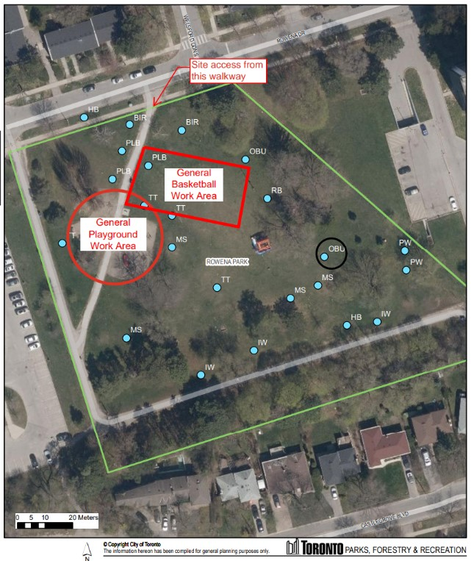
Project overview
Rowena Park is located near the intersection of Ellesmere Road and Victoria Park Avenue. The playground is in the northwest area of the park and is divided into two sections by a pathway.
What will be included
  The City is improving the playground and adding a new basketball court at Rowena Park. The playground is part of the Playground Enhancement Program. The new basketball court will be built in the park’s northeast area as part of the Parks and Recreation Facilities Plan.
  The playground will be redesigned using community feedback and is proposed to include:
    playground equipment for ages five to 12
    additional seating
    engineered wood fibre surfacing
    an accessible pathway from the sidewalk to the playground area
  Improvements will only be made in the general playground area and will not include any new water or lighting features or improvements to other areas of the park.
Notes:
Dan + Rosemary

Slide 3
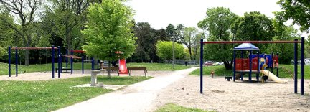
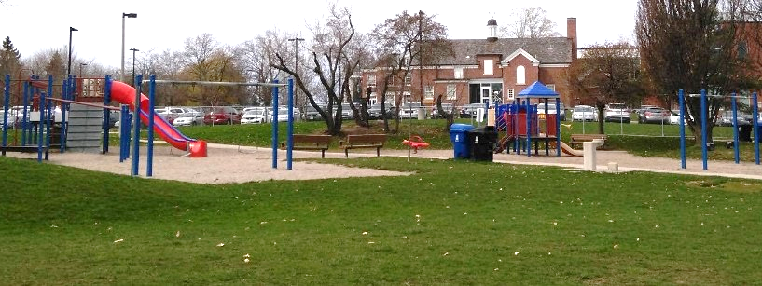
Project overview
Where are we now?:
  Concept Development Phase
    The design consultant is gathering background information and site analysis to develop design concepts.
    Finalized design concepts will be available Q1 2026, and be presented to the community in forthcoming public engagement phase.
What's Next
  Initial Public Consultation and engagement so the community can have a say in what the playground and park will include. Q1, 2026
  Construction to advance Q4, 2026 Refer to project website for updates: www.toronto.ca/RowenaPark
Notes:
Dan + Rosemary

Slide 4
Mario Pecchia
Mario.Pecchia@toronto.ca

