Slide 1
Dr. Daniel Hill Park New Splash Pad
Project Overview
November 2025

Slide 2
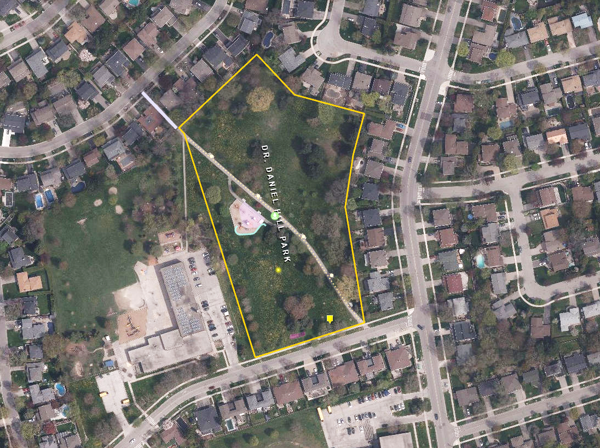
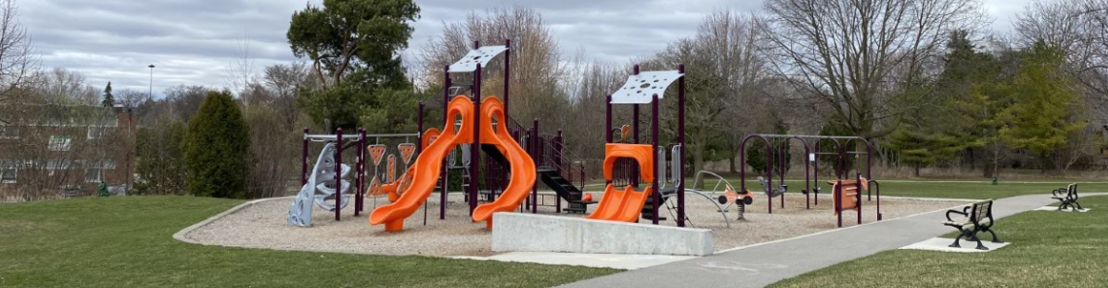
Project overview
Dr. Daniel Hill Park is located near the intersection of Underhill Dr. and Cassandra Blvd. The playground is in the northwest area of the park and is divided into two sections by a pathway.
What will be included
  The City is improving the Dr. Daniel Hill Park with a New Splash Pad.
  The splash pad will be located south of the recently improved playground and north of Casandra Blvd.
Existing Park Amenities
  Playground (Constructed in 2022)
  Bottle Filling Station
  Improved pathways
  Bench Seating
Underhill Dr.
Cassandra Blvd
Notes:
Dan + Rosemary

Slide 3
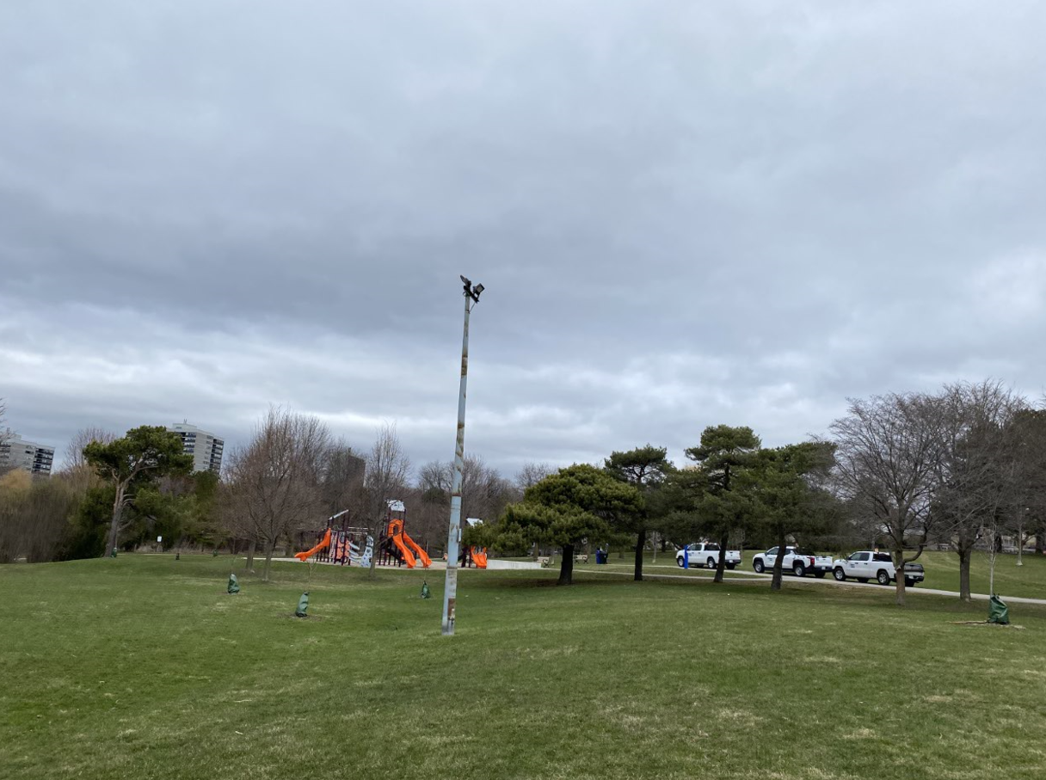
Project overview
Where are we now?:
  Concept Development Phase
    The design consultant is collecting technical information that will inform splash pad design options to present to the community through the following public engagement activities.
  Engage City Public Consultation team
    Digital Survey
      To be launched early December
      Accessed via the Project Webpage
    Pop-up Event
      January 7, 4:30-6:30pm
      Broadlands CRC (19 Castlegrove Blvd)
What's Next?
  Launch Public engagement events and share concepts with the community.
  Construction anticipated late fall 2026- Refer to project website for updates: www.toronto.ca/DrDanielHillPark
Notes:
Dan + Rosemary

Slide 4
Mario Pecchia
Mario.Pecchia@toronto.ca

